Slide 1
Why Python or a Brief History of Computer Languages.

Slide 2
How Does a Programming Language Work

Slide 3
How Does a Computer Work?

Slide 4


Von Neumann Architecture
Computer
Control Unit
Ok, but how is this executed exactly?
Central Processing Unit (CPU)
Clock
Input Device
Output Device
Arithmetic/Logic Unit
Memory

Slide 5
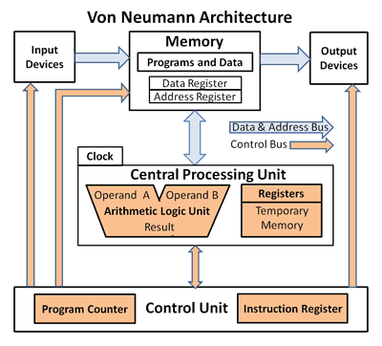

Slide 6
The Pioneers (Pre-Vacuume Tube Age ~1800s - 1907)

Slide 7
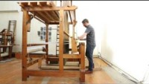
1804 – Joseph Marie Jacquard
The Jacquard loom
Used Punch Cards system to recreate complex patterns on a loom.

Slide 8
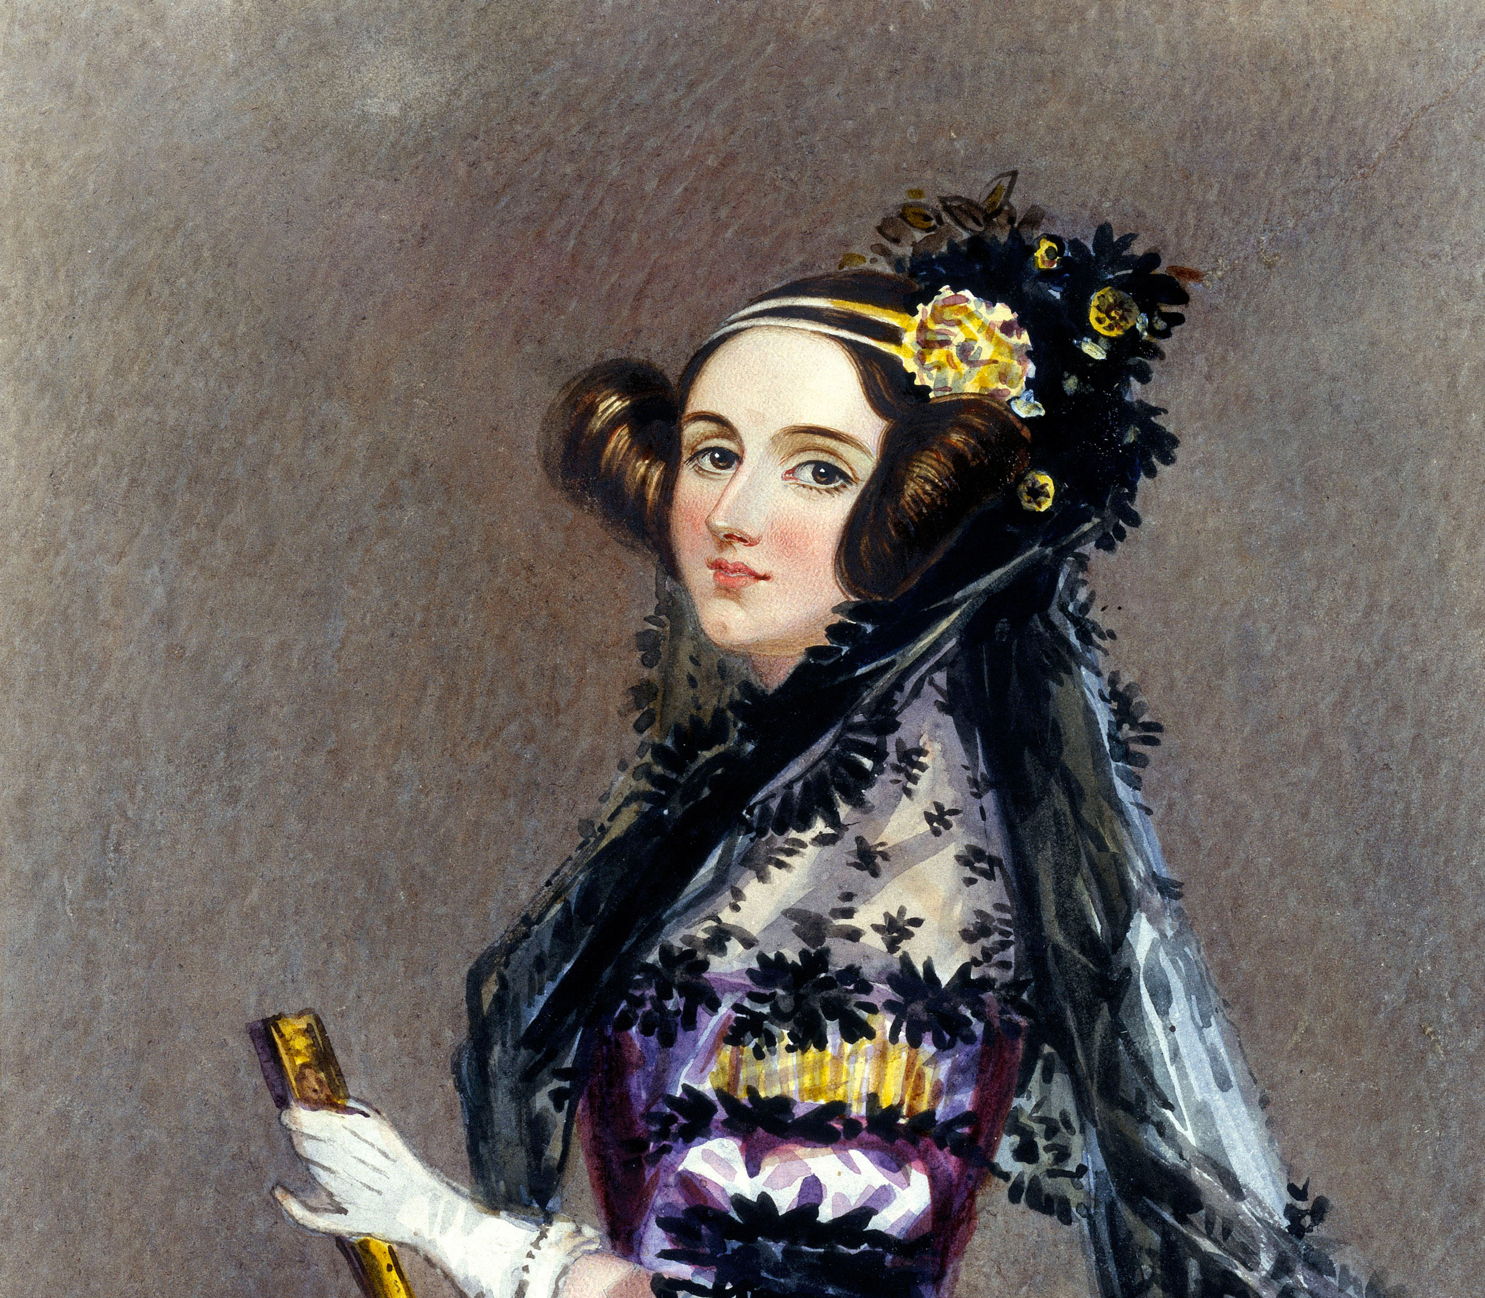
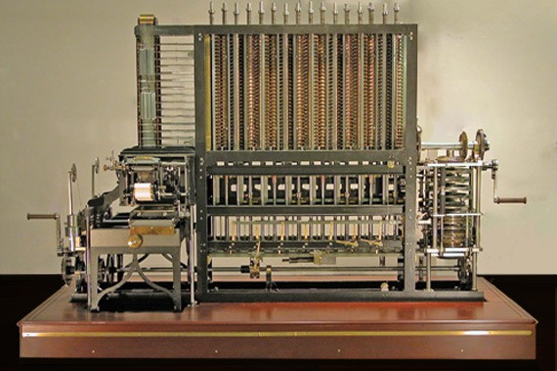
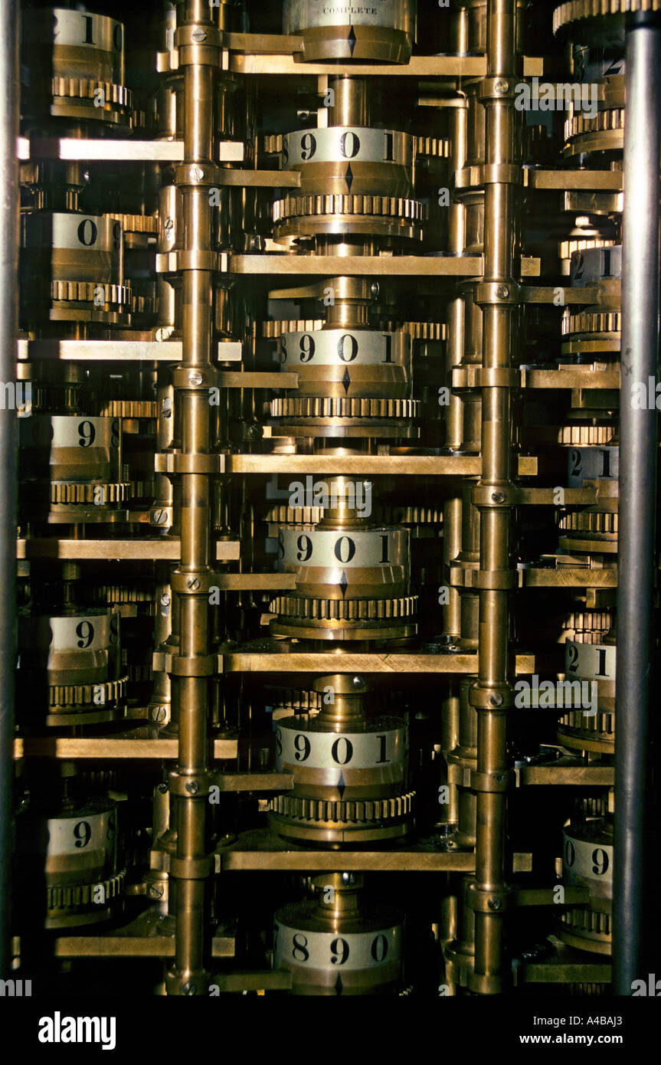
1883 – Ada Lovelace
First Programming Language to Calculate Bernoulli numbers
Created for a Victorian Steam Powered Calculator
A Primitive Computer

Slide 9
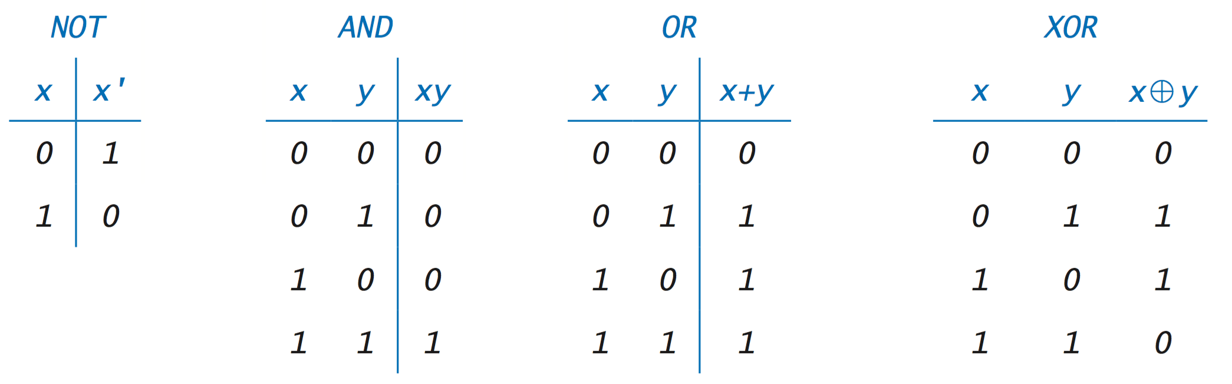
1886 – Boolean Logic & Logic Gates
In mathematics, a Boolean function is a function whose arguments and result assume values from a two-element set (usually {true, false}, {0,1} or {-1,1})

Slide 10
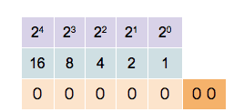
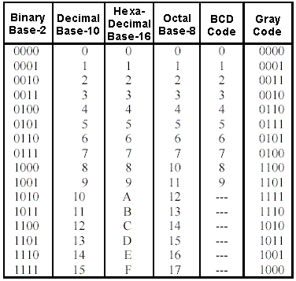
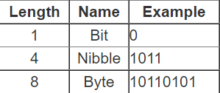
REMEMBER: Computers Count in 1s and 0s AKA Binary Notation

Slide 11
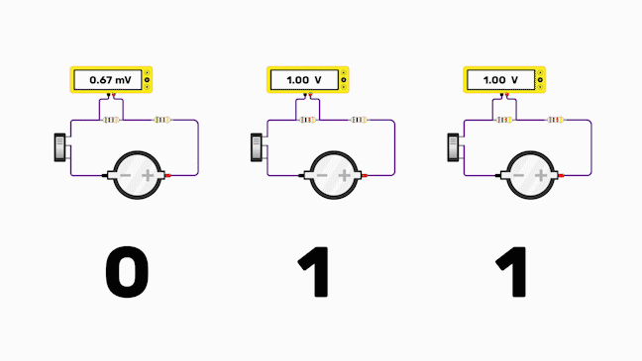
How do you represent 1 and 0 electrically?

Slide 12
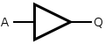
1886 – Boolean Logic & Logic Gates
Buffer Gate
INPUT | OUTPUT
A | Q
0 | 0
1 | 1

Slide 13
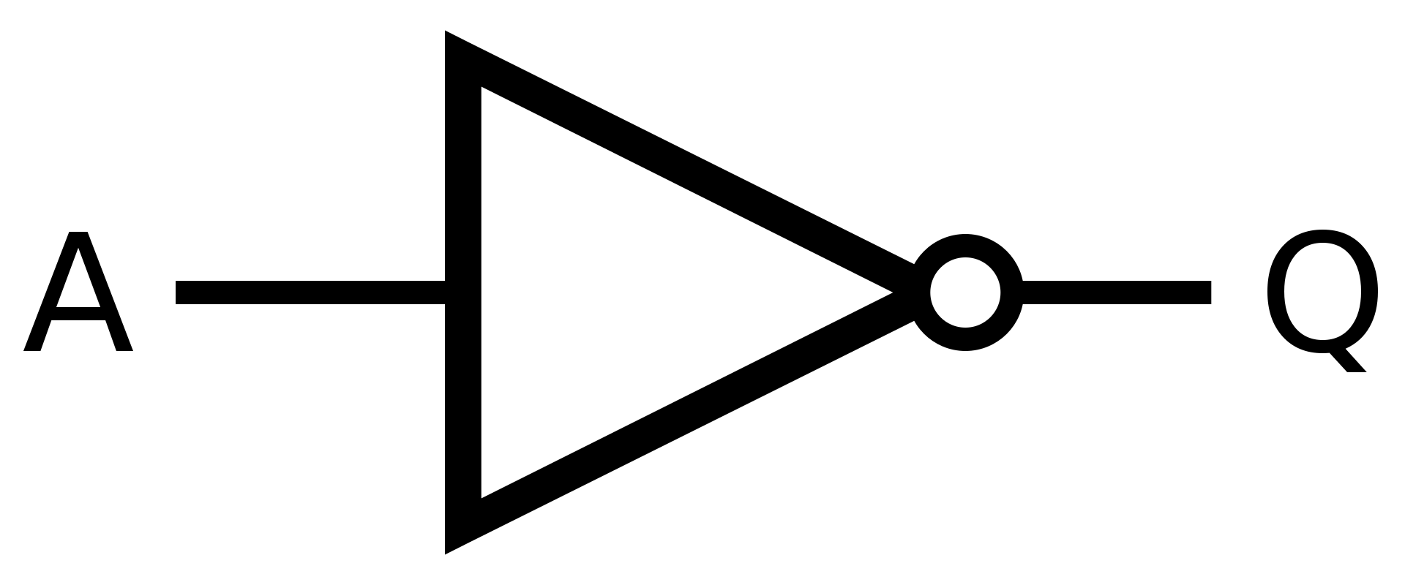
1886 – Boolean Logic & Logic Gates
Inverter Gate
INPUT | OUTPUT
A | Q
0 | 1
1 | 0

Slide 14
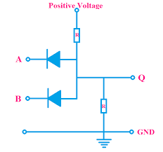
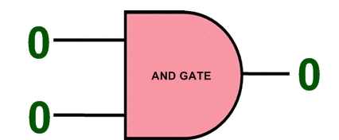
1886 – Boolean Logic & Logic Gates
AND Gate
INPUT |  | OUTPUT
A | B | Q
0 | 0 | 0
0 | 1 | 0
1 | 0 | 0
1 | 1 | 1

Slide 15
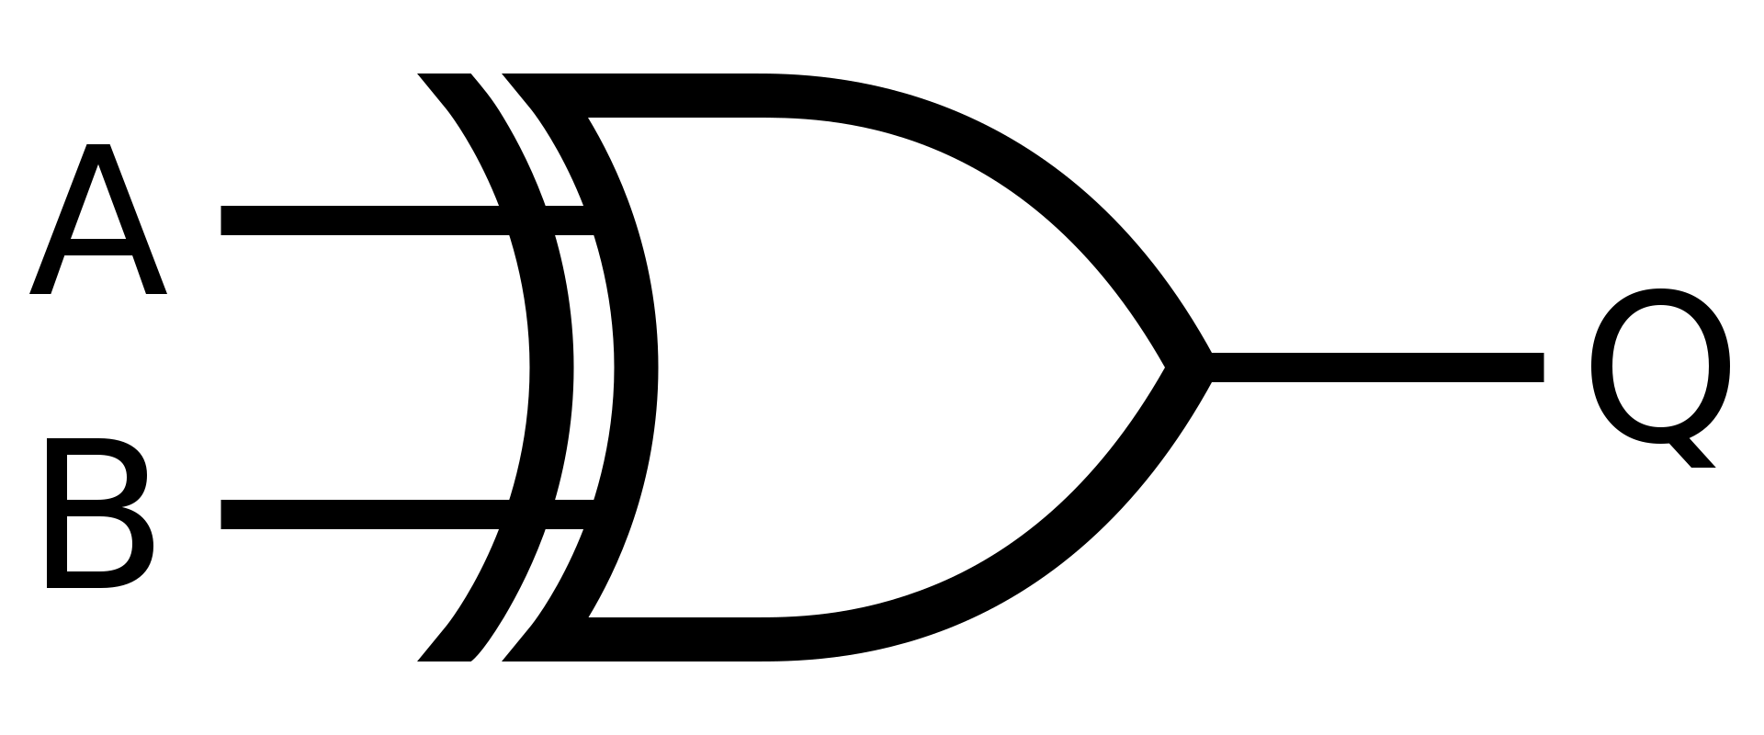
1886 – Boolean Logic & Logic Gates
XOR Gate
INPUT |  | OUTPUT
A | B | Q
0 | 0 | 0
0 | 1 | 1
1 | 0 | 1
1 | 1 | 0

Slide 16
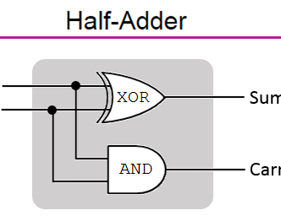
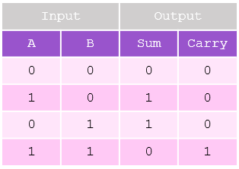
1886 – Boolean Logic & Logic Gates

Slide 17
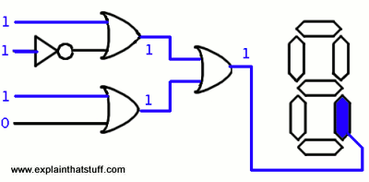
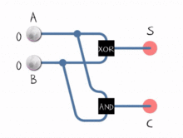
1886 – Boolean Logic & Logic Gates

Slide 18
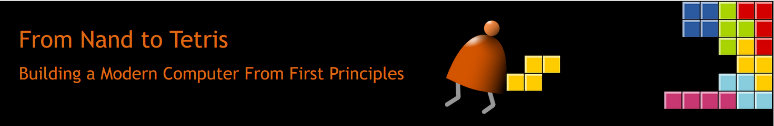
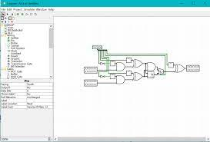
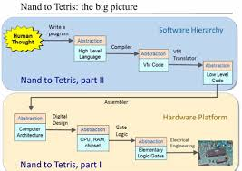
Nand To Tetris

Slide 19
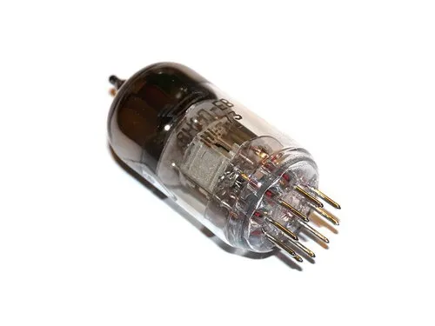
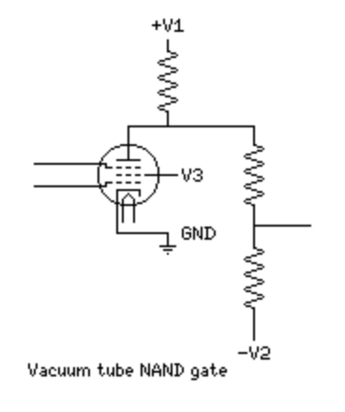
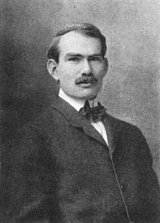
1907 – Vacuume Tubes
Lee de Forest Created the first electronic gates using Vacuum Tubes
The main advantage of using vacuum tube technology:
Speed of Electron is greater than any mechanical based calculator
The Vacuum environment is not susceptible to electro-magnetic interference
A
B
O

Slide 20
The Monsters (Pre-Transistor Age -1907s ~ 1950)

Slide 21
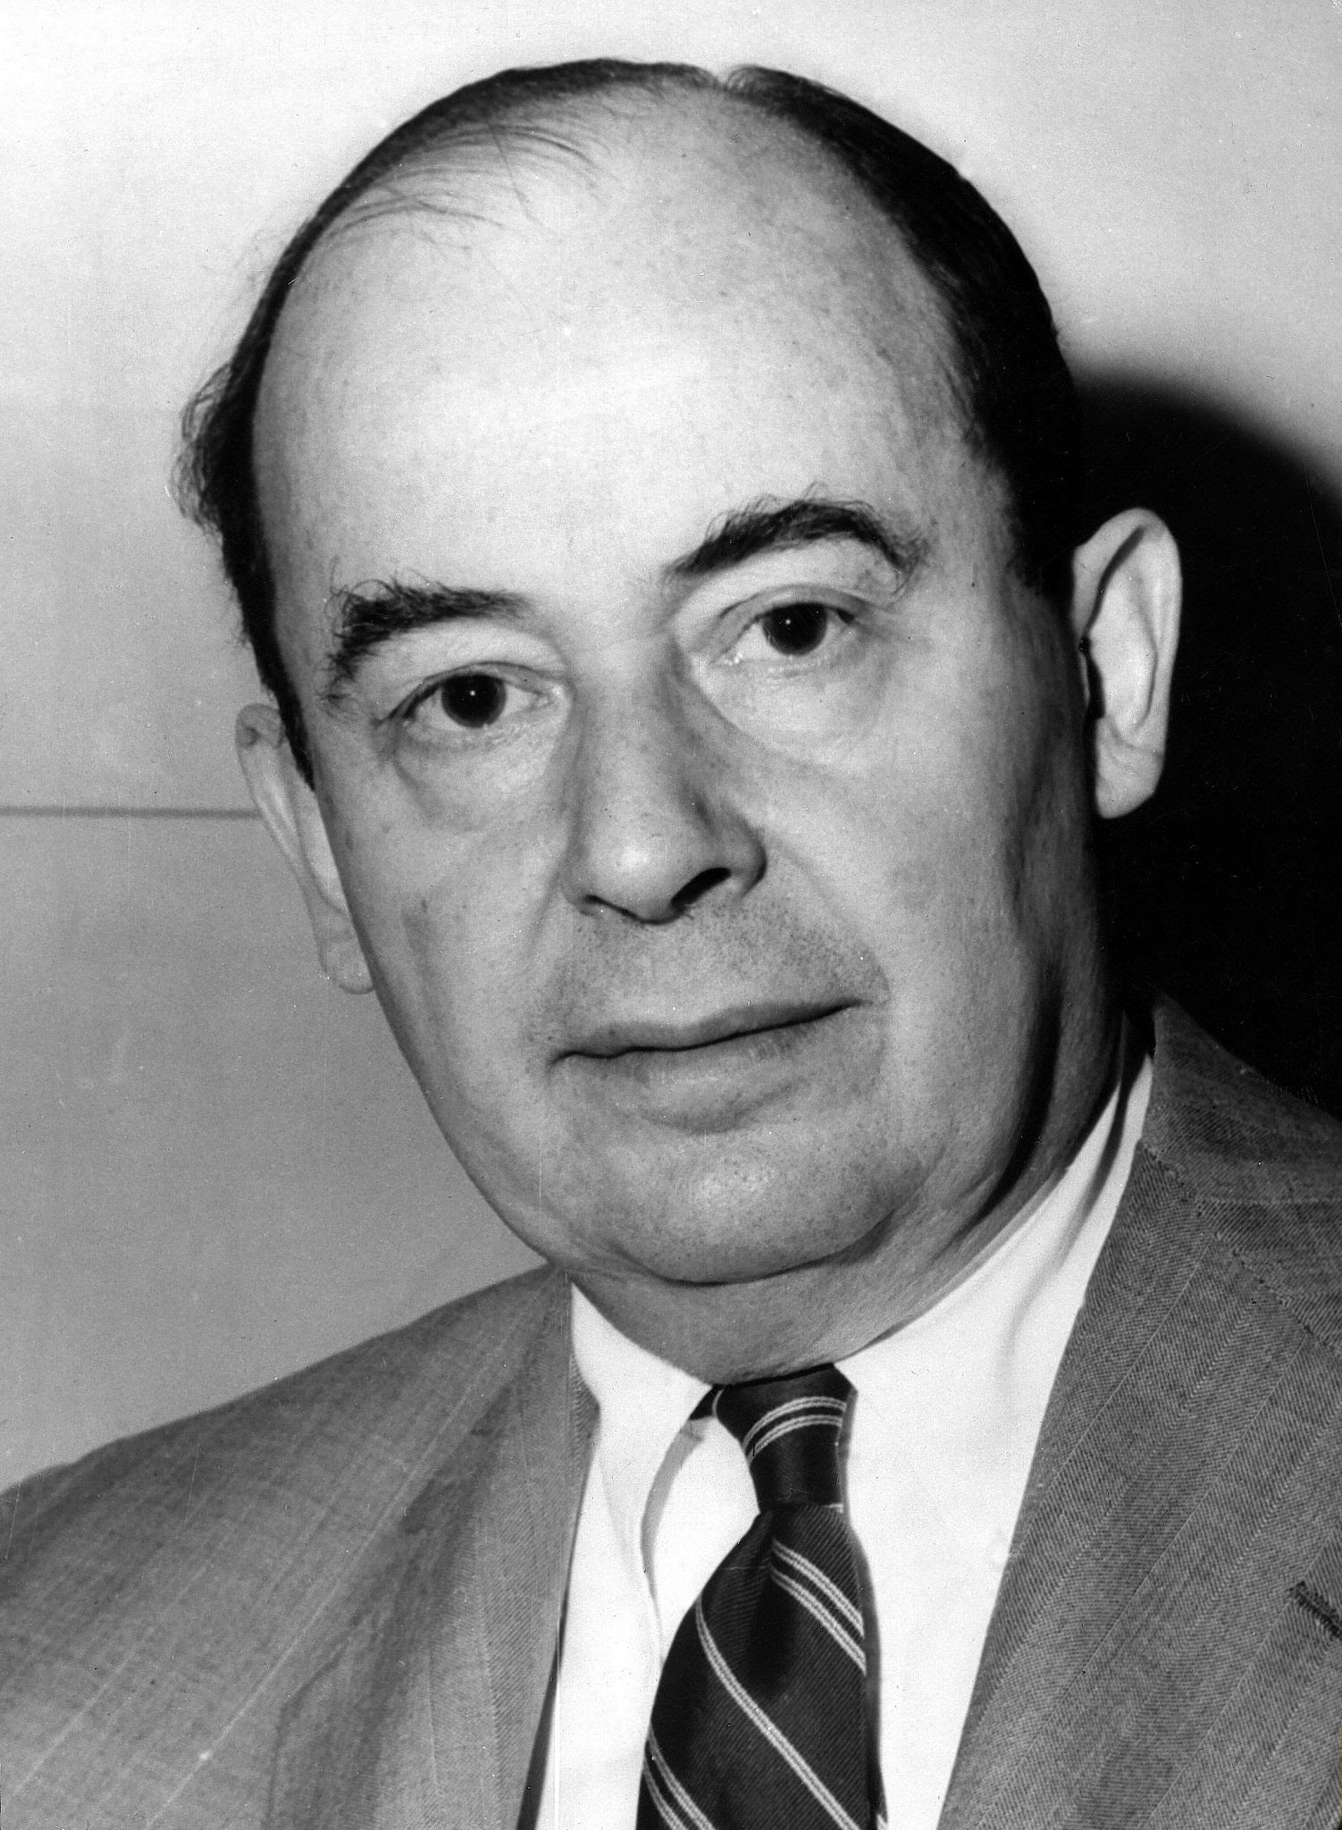
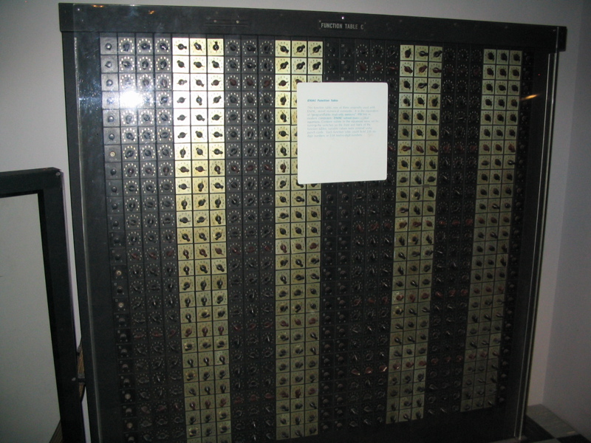
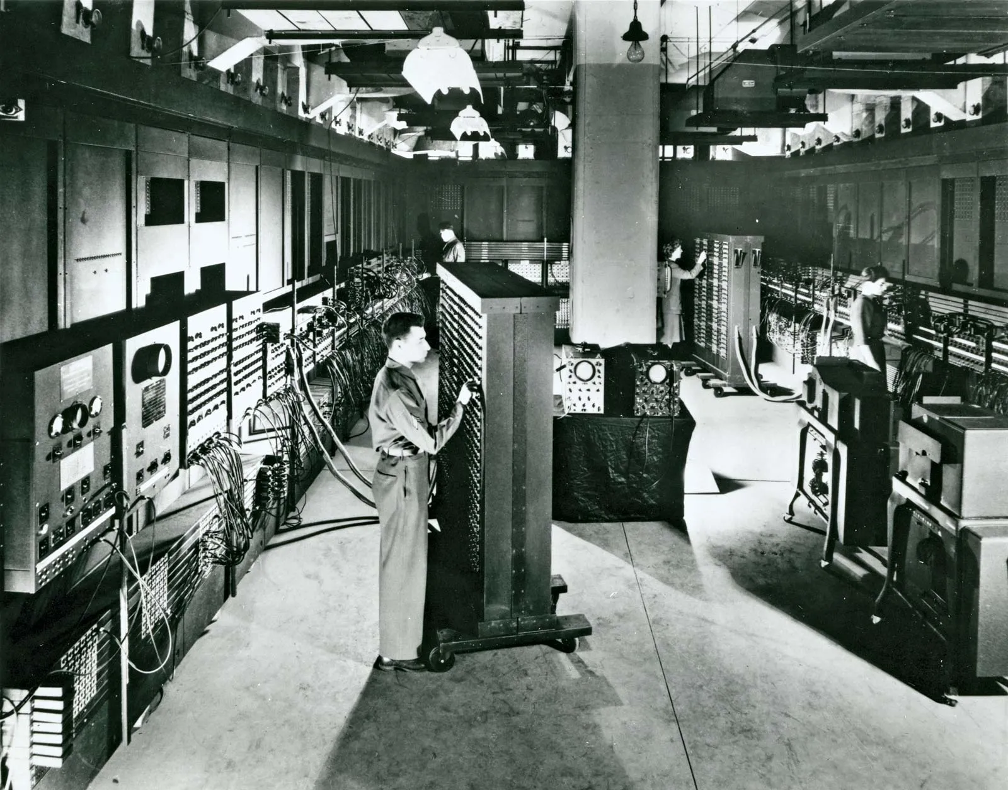
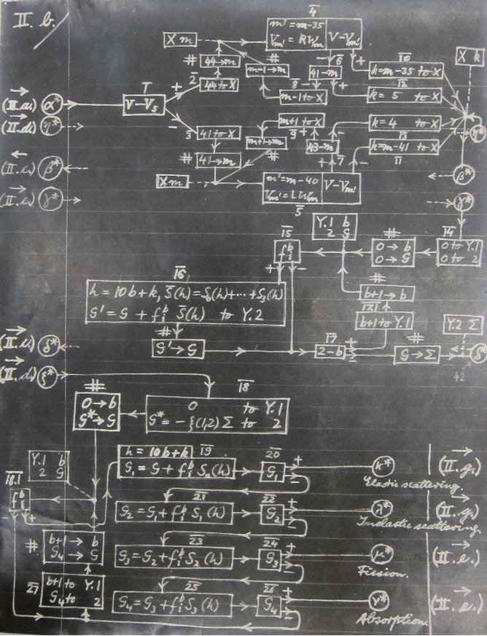
1943 – ENIAC coding system
John Von Neumann Described the first computer memory.
Computers Would Use binary notation
Computers would be fed instructions which would be stored in memory and then execute those instructions. Instructions can come in Magnetic Tapes, Punch Cards or other external memory devices.
EINAC Function Table Used to feed the machine instructions

Slide 22
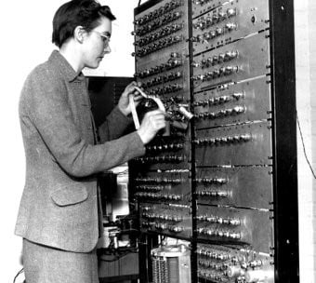
1947 – ARC/Birkbeck Assembler
Kathleen Booth invented the first assembly language (Machine Code)
It’s primary purpose was to move commands from one register to another .
This allows for the creation of subroutines.
Used with Punch Cards

Slide 23
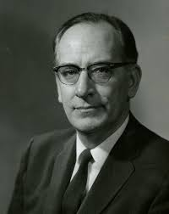
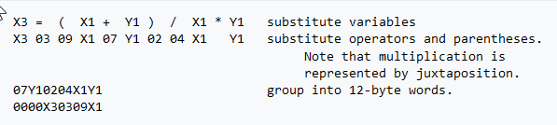
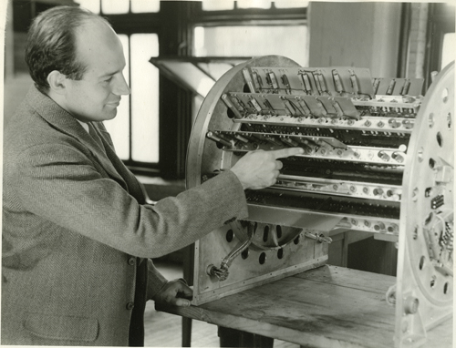
1949 – Short Code
John Mauchly created one of the first interpreted languages
Comands can be writen in plain mathematical expressions and then translated to machine code
Was 50 times slower than machine code

Slide 24
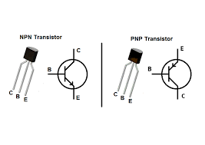
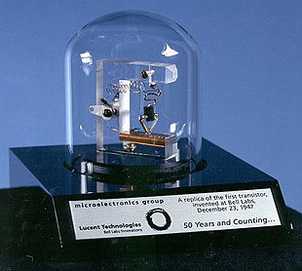
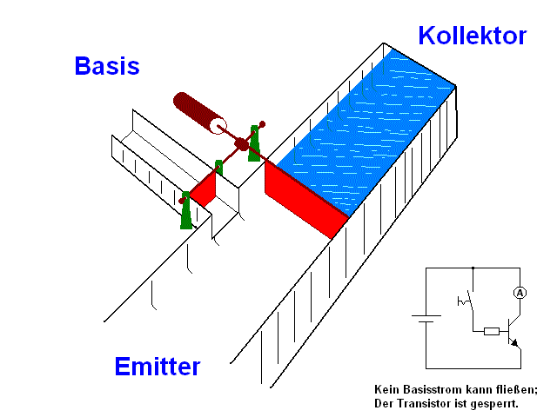
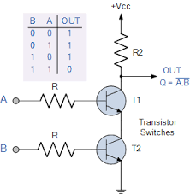
~1950 – Transistors
The main issue with vacuum tubes is that they have a very short use-life & consume a lot fo electricity
Transistors don’t need a vacuum to operate in, are much smaller and much more energy efficient.
This allows to make things much smaller

Slide 25
Higher Level Languages (1950s ~ Current)

Slide 26
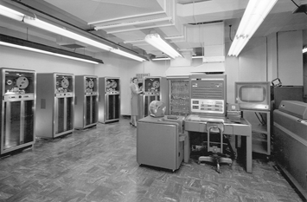
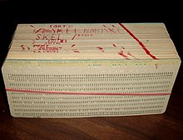
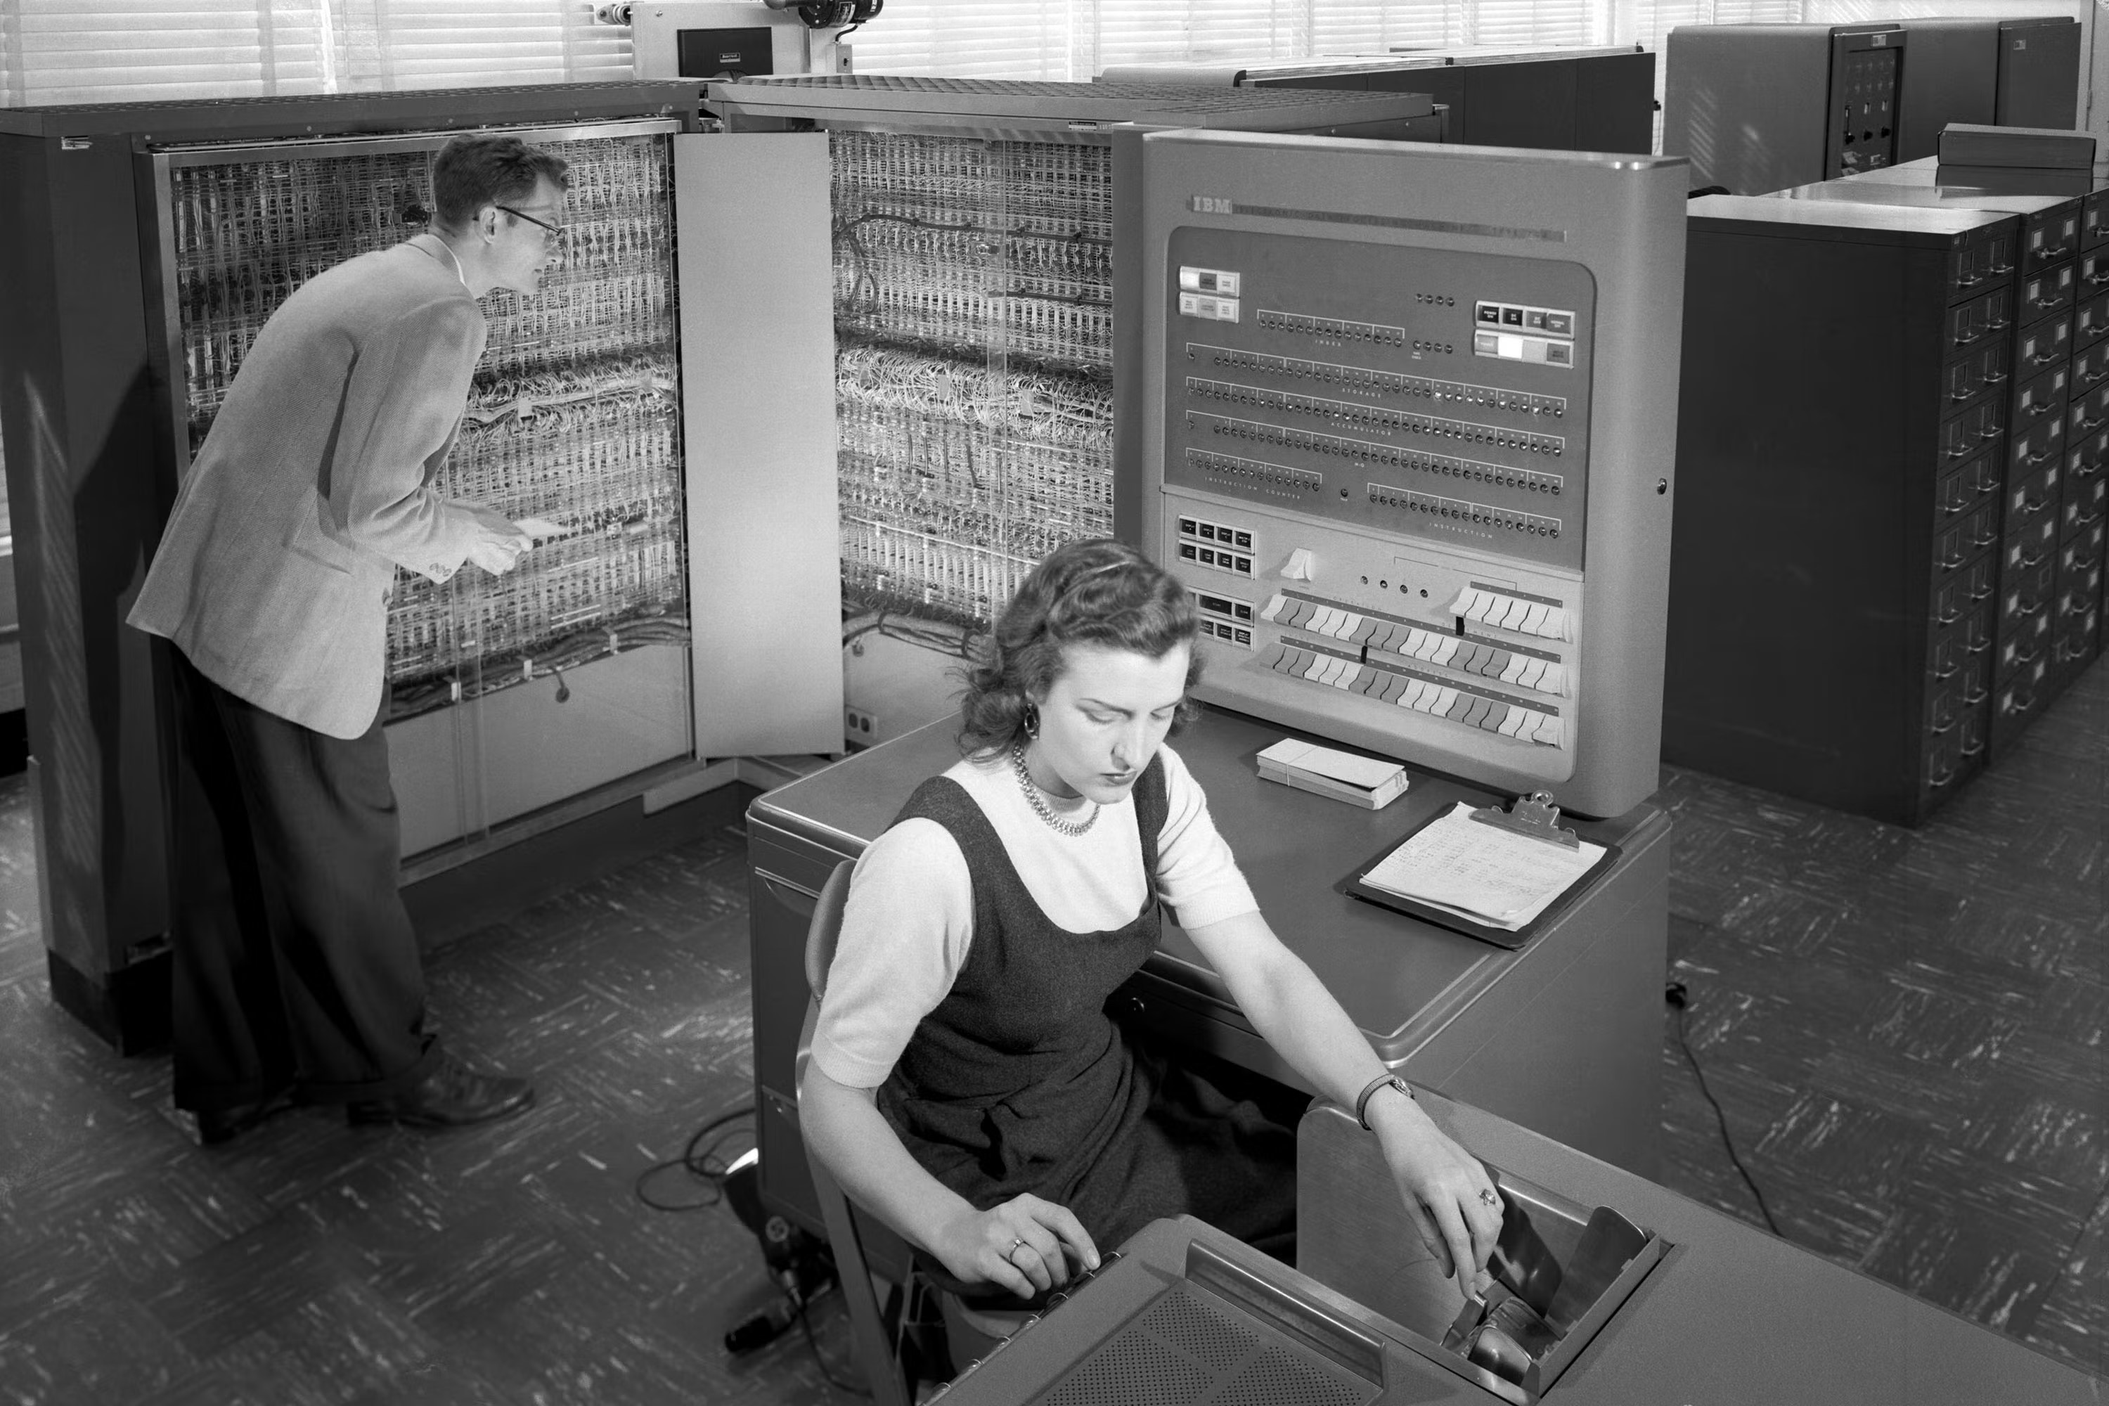
1954 – Fortran
Developed by IBM
First use of statements IF, GOTO, etc to manipulate switches and create sub routines.
Still running today

Slide 27
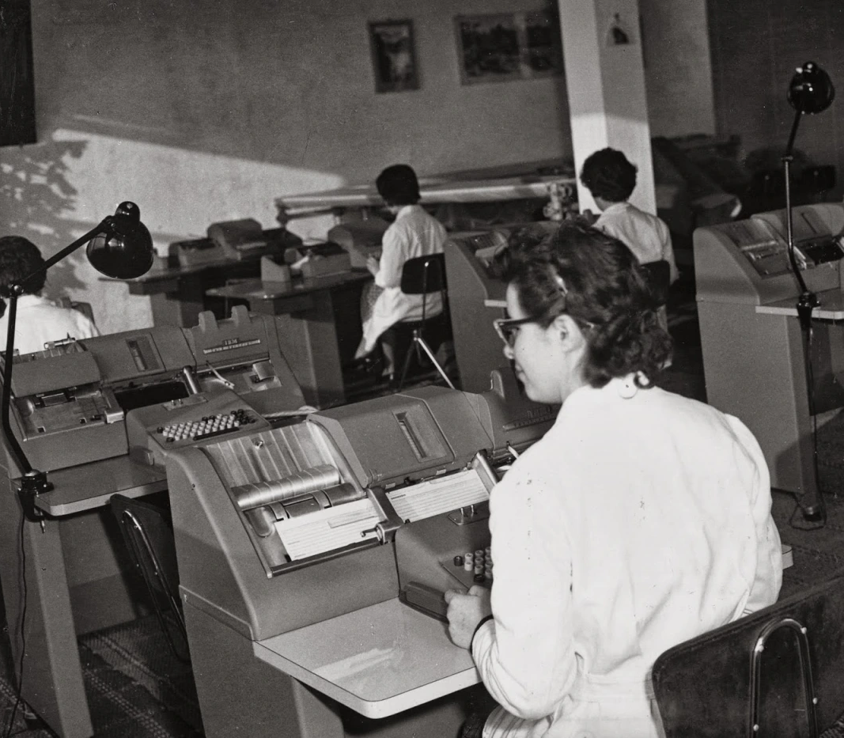
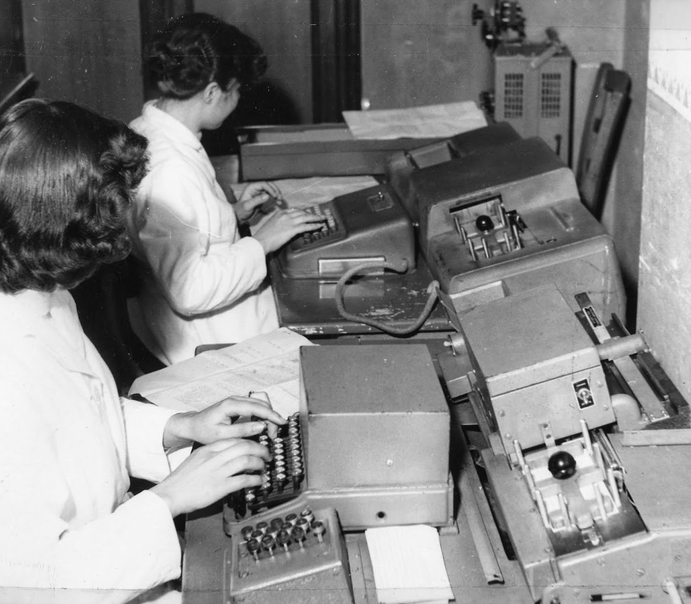
Female Punch Card Operatives

Slide 28
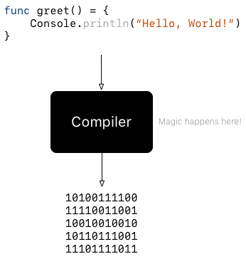
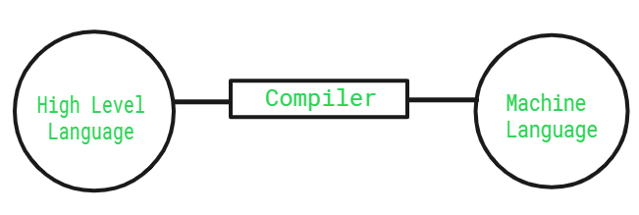
Compilers

Slide 29
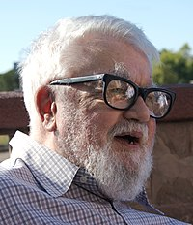
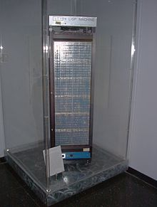
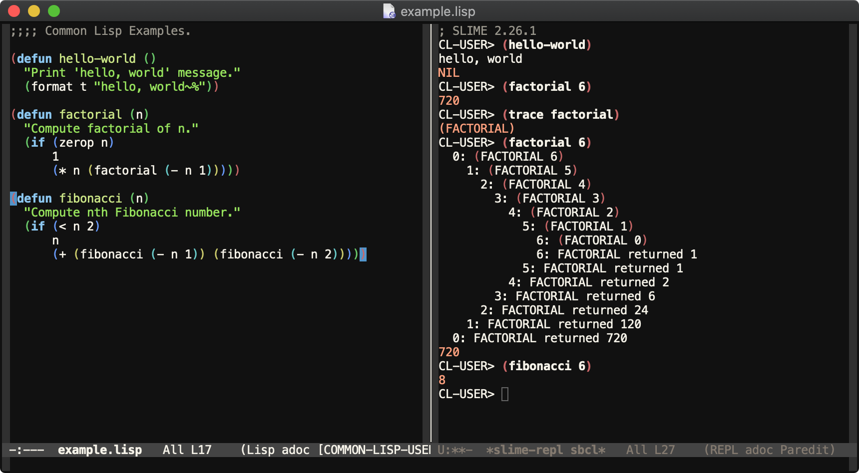
1958 – Lisp
Developed by John McCarthy
First Commercial Compiled Language
Introduced List-processing and Recusion
Still used by Boeing and Other companies

Slide 30
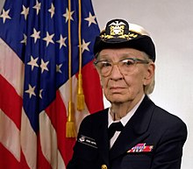
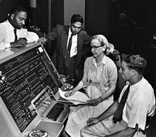
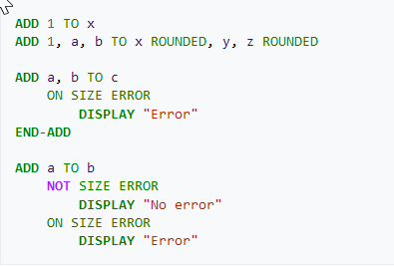

1959 – COBOL
Developed by Grace Hopper
Common Business Oriented Language
Used English Syntax
Still Used today by Banks in most ATMs.
Grace Hopper is also credited as inventing the first ever compiled language called A-0 in 1951

Slide 31



1964 – BASIC
Developed by Dartmouth College
Beginners All-Purpose Symbolic Instruction Code
For people to use without the need for complex mathematical knowledge
Popular foor mini-computer use

Slide 32



Advancements in Computer Peripherals
First Floppy Disk – IBM 1971
First Electronic Keyboard – Altair 1970
First Computer Mouse – Douglas Engelbart 1967

Slide 33


First IDEs
Dartmouth BASIC - 1964
Xerox SmallTalk - 1970

Slide 34



1972 – C
Developed by Denis Ritchie
For the Unix Operating system
Father of almost all Contemporary Languages
Still widely used

Slide 35



1983 – C++
Developed by Bjarne Stroustrup in Aarus University!
An extension of C providing OOP principles
One of the most used languages

Slide 36



1991 – Python
Named after Monthy Python
Developed by Duch CS Guido Van Rossum.
Minimalist User Syntax
One of the most popular computer languages

Slide 37


And Many More

Slide 38
So which language is the best?

Slide 39
What’s next?

Slide 40
Lesson 2
Next Time!
Git & Version Control
Lists & Other Data Structures
Loops
Maybe… Classes and OOP principles part I
Before Next Time:
Exercises
Come up with one thing in your day-to-day life that you can automate. Break Down the Problem and Explain the steps needed to automate it. DO NOT THINK IN PYTHON!

Slide 41
How I am envisioning this… for now
IoS and Android Development
Occasional
IT History & Common Knowledge
Data Science
Part 1
Part 2
Part 3
Web Development
Python General Knowledge
General Computer Science Knowledge
Specialization
Embedded Systems
Continuous
Exercises and Projects
Game Development

Slide 42
How I am envisioning this… for now
Exercises & Teaching
Projects

